Slide 1
Software Accessibility – Mar 07
Agenda
Module D.2 Software Accessibility
Pick a Partner / Pick a Topic
Begin Research / Presentation Slides
Presentations Due: Monday, March 18th
Marks Spreadsheet
Individual Conferences
Complete C.2 Emoji Equity
Upcoming
Monday Mar 18th : Accessibility Presentations Begin

Slide 2

Regionalization
Look at your Smart Phone / Computer Screen
How would it look to a person living in a small country?
e.g. Iceland
What would they have to do to use it to its full potential?

Slide 3
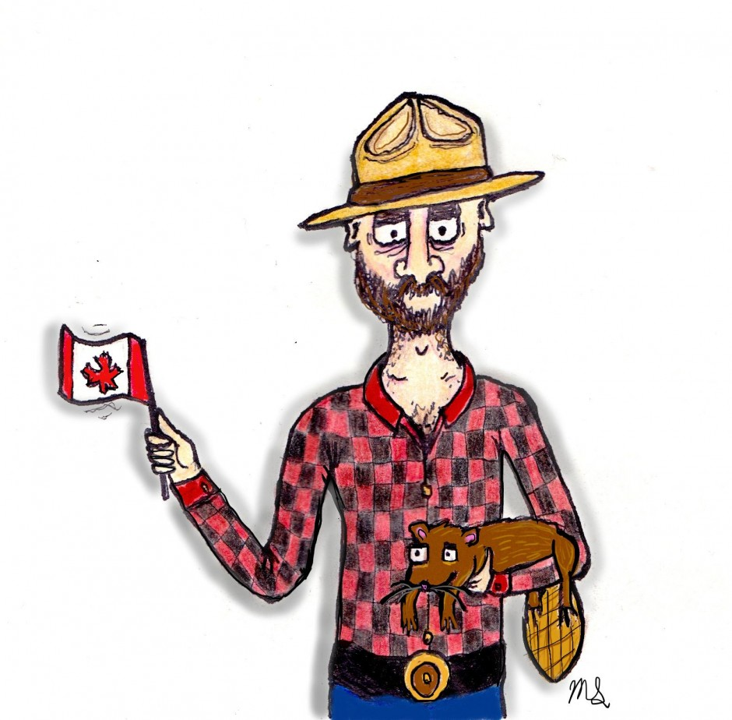
Regionalization
What about being Canadian?
Words
Colour vs. Color
Centre vs. Center
etc.
Date Format
3/7/19 or 7/3/19

Slide 4

Accessibility
Look at your Smart Phone / Computer Screen
Could you use it if…
You were visually impaired?
You were hearing impaired?
Had motor coordination issues?

